Slide 1
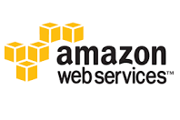
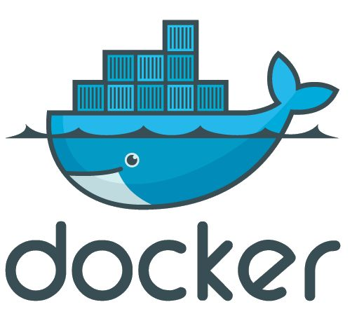
Introduction to
+
By Rudy Gunawan

Slide 2
Agenda
What is AWS
Demo on AWS
- Docker
- DockerHub
Q & A

Slide 3
What is AWS
AWS stands for Amazon Web Services, which is a secure cloud services platform, offering computing power, DB Storage, Content Delivery and other functionality to help business to scale.

Slide 4
Easy to use AWS is designed to allow everyone to quickly and securely host application
Flexible It enables you to select OS, language, DB and other system you need.
Cost Effective
You only pay what resource you use – no contract – no commitment
Secure AWS use end to end approach to secure and harden your infrastructure
Improves time to Market Focus on your business instead of other things
Procurement
Procuring a new server might take time between several hours to weeks, however AWS enables you to spin off a new server within few minutes.
Real Elastic Scalability You can scale up or down using auto scaling, AWS Tools, or Elastic Load Balancing – based on your demand

Slide 5
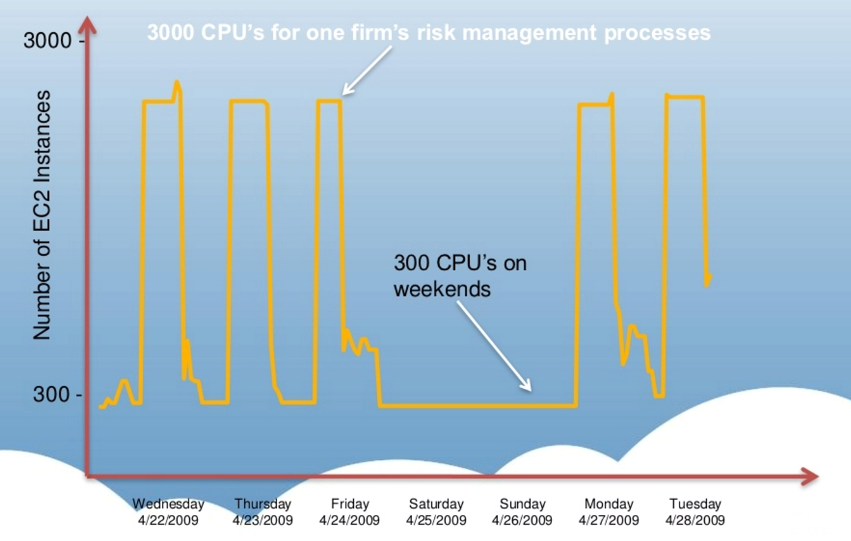
Elastic scalability

Slide 6
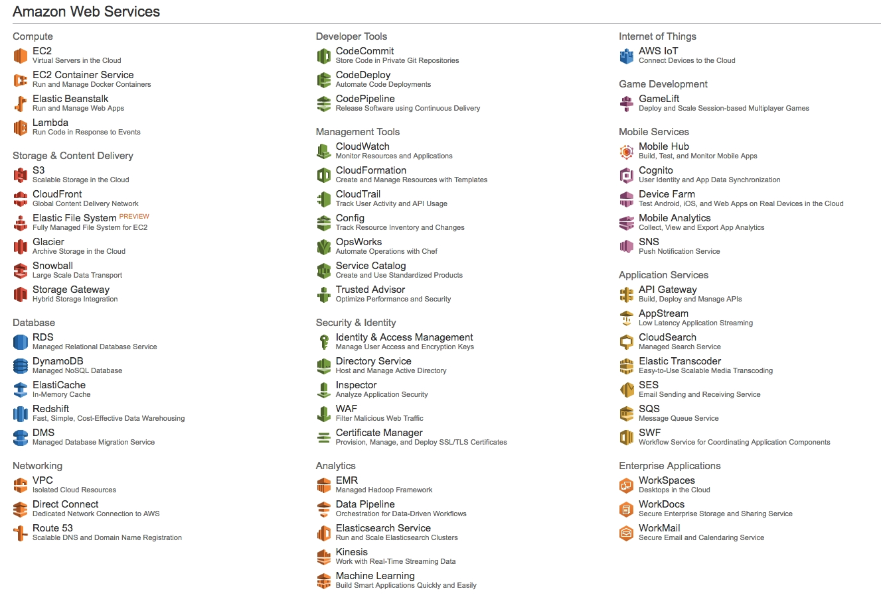
AWS Products

Slide 7
Do you need to use them all?
NO

Slide 8
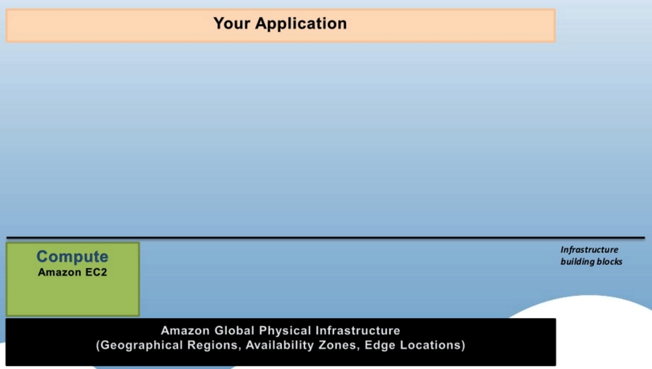
Building blocks : your cloud is living and evolving – 10 concurrent users

Slide 9
Amazon EC2
EC2 stands for Elastic Compute 2
EC2 = Virtual Machine
EC2 is on-demand compute power
EC2 supports windows, Linux, FreeBSD, Solaris etc
EC2 supports all major web and application platform
Full control : root or administrator rights
Secure : Firewall via Security Groups
VM import / export : You can save your image or create new instance using your image ( AMI - Amazon Machine Image)

Slide 10
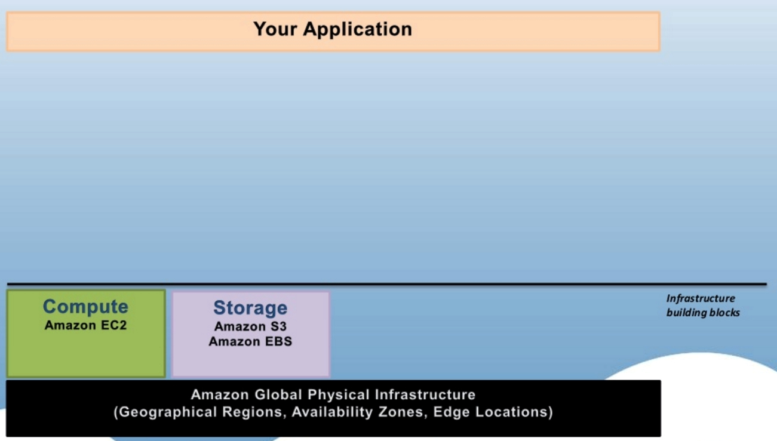
Building blocks : your cloud is living and evolving contd – 100 concurrent users

Slide 11
Amazon S3
S3 stands for Simple Storage Services
In traditional on premise Application, this kind of data maintained by SAN / NAS
S3 has buckets + folders
Up to 5TB per object
Unlimited storage of object of any type

Slide 12
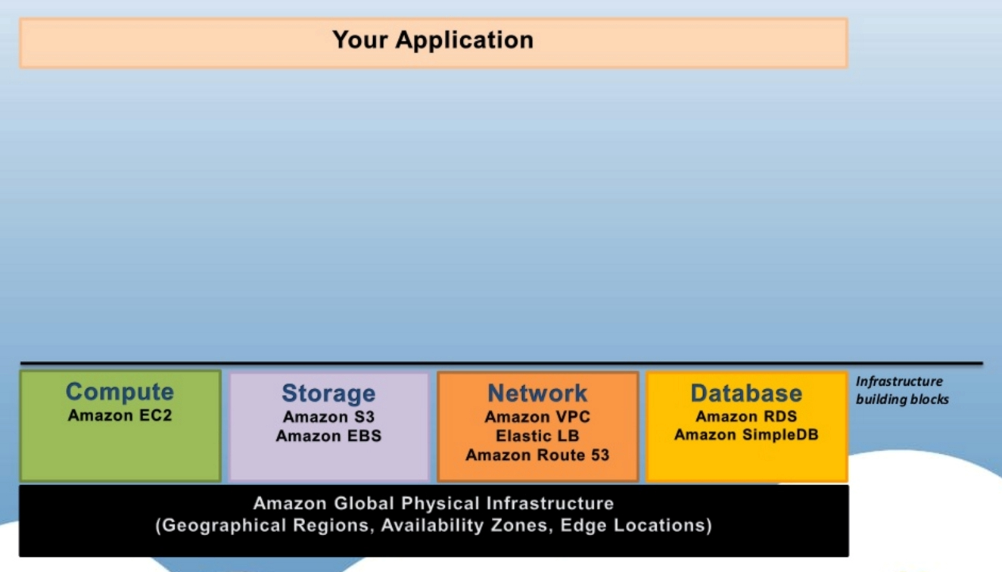
Building blocks : your cloud is living and evolving contd – 1000 users
Amazon DynamoDB

Slide 13
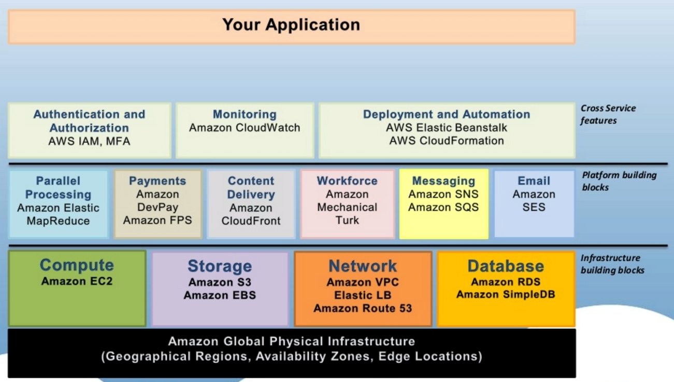
Building blocks : your cloud is living and evolving contd ( 5000 +++ users )
Amazon DynamoDB

Slide 14
Demo – 9Gag Simple Clone
Basic Functionality :
Able to submit new post, which contain image
Able to see other people post, sorted by created date

Slide 15
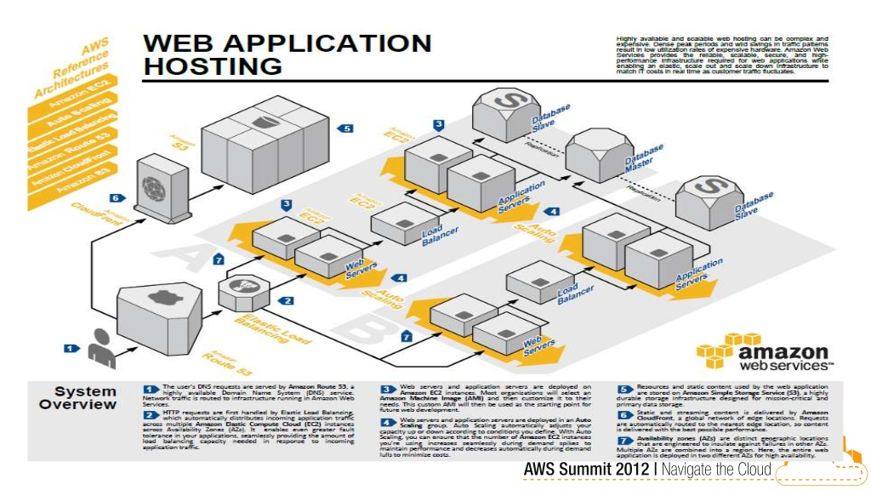
AWS Web Application Reference

Slide 16
Steps
Download the SDK
Download the Security Credentials
Setup S3
Setup DynamoDB
Setup EC2 Instance
Setup Cloudfront
Finally, start code using the provided SDK

Slide 17
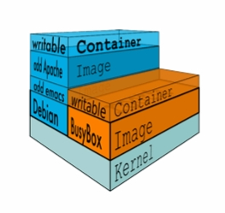
What does docker do?
Docker containers wrap up a piece of software filesystem that contains everything it needs to run : code, runtime, system tools, environment variables , system libraries – anything you can find in server
Docker guarantees that it will always run the same, regardless of environment it is running it

Slide 18
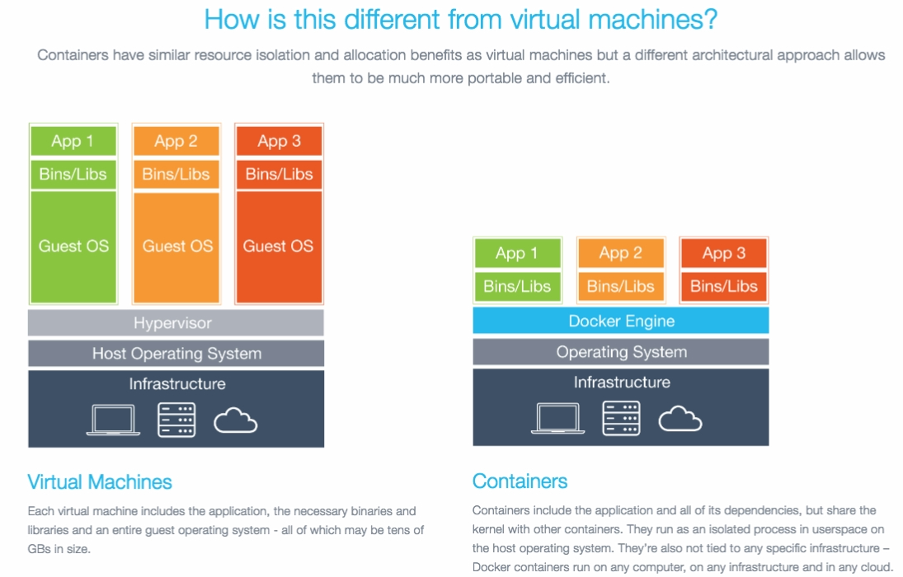

Slide 19
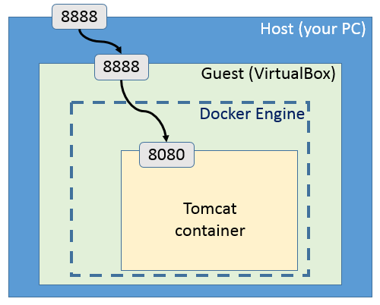
Docker port forwarding

Slide 20
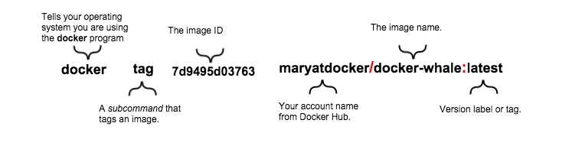
Docker Tag

Slide 21
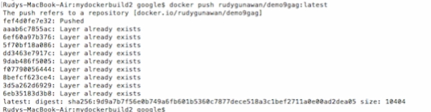
Docker Push

Slide 22
Q & A

